Slide 1
Performing radiation therapy research using the open-source SlicerRT toolkit
Csaba Pinter¹, Andras Lasso¹, An Wang², Gregory C. Sharp³, Kevin Alexander⁴, David Jaffray², and Gabor Fichtinger¹
¹Laboratory for Percutaneous Surgery, Queen’s University, Kingston, ON, Canada ²University Health Network, Toronto, ON, Canada
³Department of Radiation Oncology, Massachusetts General Hospital, Boston, MA, USA
⁴Department of Physics, Eng. Phys., and Astrophysics, Queen’s University, Kingston, ON

Slide 2
Radiation therapy challenges
Research
3D Dosimetry
Computational methods
Knowledge-based RT
Image registration
Novel radiation protocols
Image/contour comparisons
?
Outcome prediction
Adaptive RT
Image segmentation
Image-guided RT
Treatment planning
Fractionation data management
Routine

Slide 3
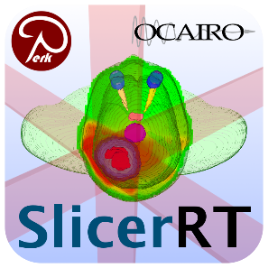



Hub for RT research workflows
Routine
Dose computation, Contouring, etc.
XiO®
Pinnacle³
Eclipse™
Data transfer
Conversions
2D/3D visualization
Dose analysis
Contour analysis
Segmentation, Registration
DICOM-RT
Custom tools: Registration, Segmentation, Dose engine, etc.
Research
Pinter et al. (2012). SlicerRT: Radiation therapy research toolkit for 3D Slicer. Medical physics, 39(10), 6332-6338.

Slide 4
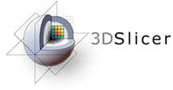
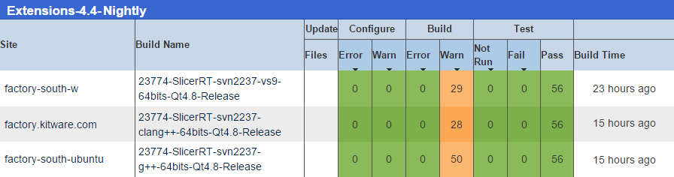
Development principles
Based on consensus discussions with RT researchers
Cover most common RT research workflows
Leverage existing tools: 3D Slicer¹, Plastimatch²
Free, open-source license (BSD)
Open to integrate algorithms
Contribute common functionality back to libraries
Documentation and examples
High quality software, developed using industrial standards
¹ S. Pieper et al. 2004
² G. C. Sharp et al. 2010
SlicerRT dashboard, performing automatic testing every night

Slide 5
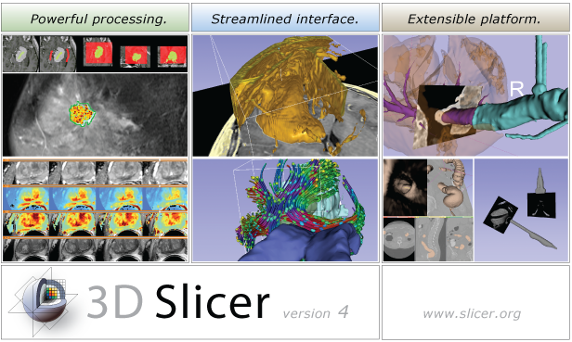
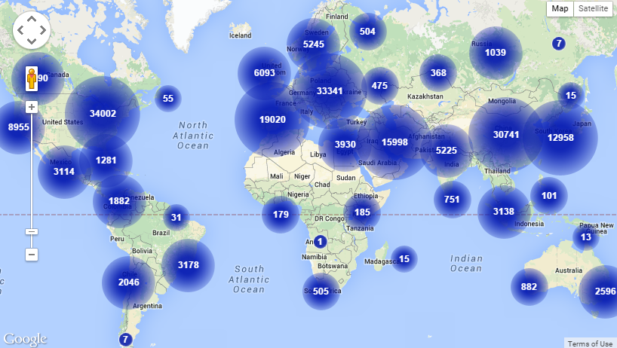
3D Slicer
Medical image analysis and visualization platform
Developed since 1997
$50M in funding (>2,000 years of labor)
Well engineered core
Over 1,000 analysis functions
Available at www.slicer.org
3D Slicer downloads

Slide 6
Translational research
Commercial treatment planning systems (TPS)
Existing research tools CERR, PLUNC, dicompyler, etc.
Inconvenient
Limited feature set
Expensive
Not flexible
Insufficient user and developer support
Cover only routine clinical procedures
Open-source?
Well documented
Free
Poor documentation
Not extensible
Large, non-modular code base
Extensible
User-friendly
Closed
Stable
Flexible
Unstable
Open-source
Platform-independent
SlicerRT

Slide 7

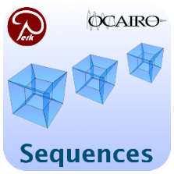

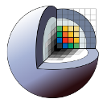
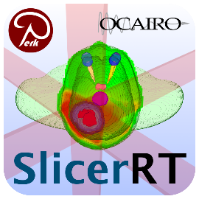
SlicerRT ecosystem
Workflow-based applications
Utilities
3D Slicer
SlicerRT core
Several former SlicerRT features integrated:
Subject hierarchy, DICOM export, Transform visualizer
Common RT software tools, acts as a platform
The most downloaded 3D Slicer extension by far

Slide 8
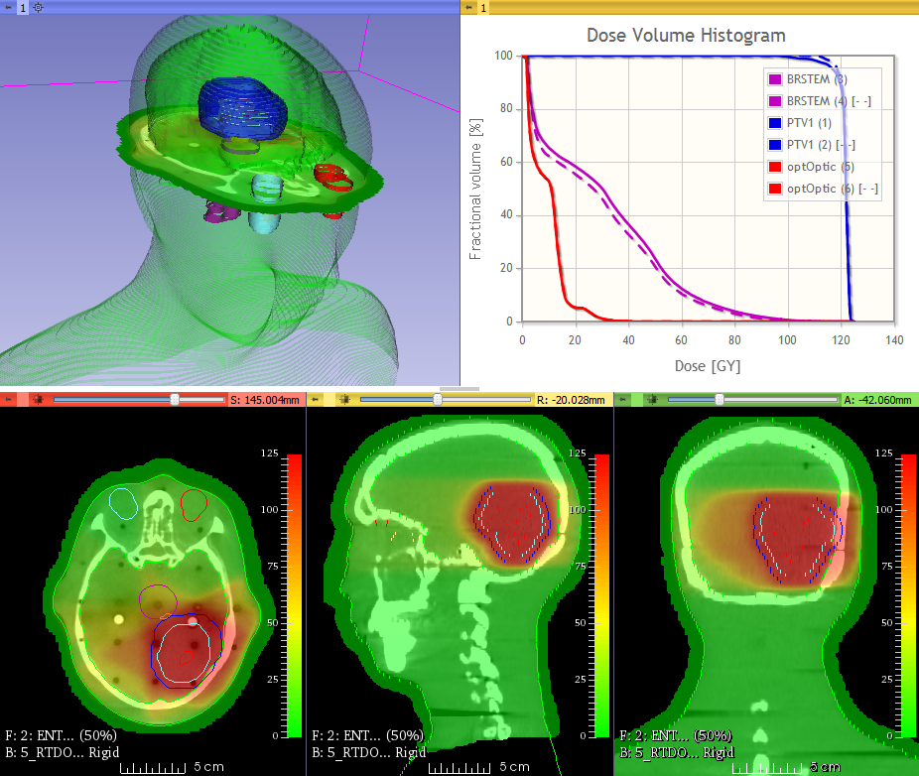
Example use case: Image-guided RT
Determine displacement between plan and daily setup
Evaluate dosimetric improvement (DVH, gamma)
Export patient setup correction
Dosimetric improvement after patient setup correction

Slide 9
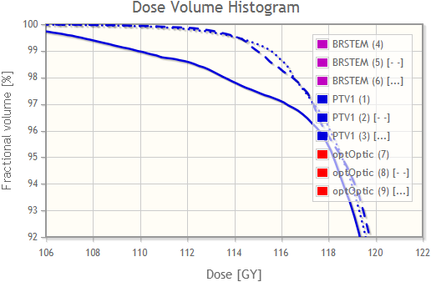
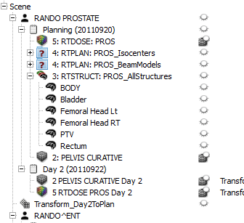
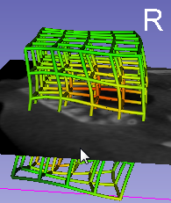
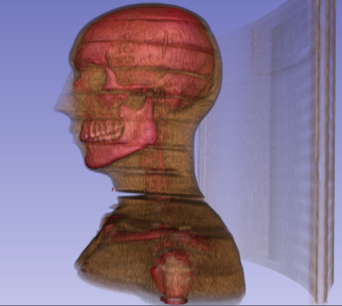
Example use case: Dose accumulation
Register anatomical images
Transform whole studies
Accumulate dose
Compute DVH
Evaluate plans using DVH
Transform whole study in data view
Visualize transforms, anatomy in 3D

Slide 10
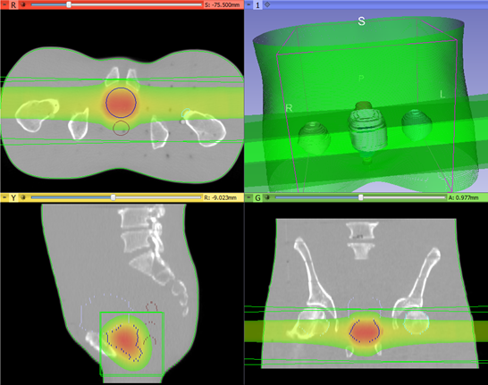
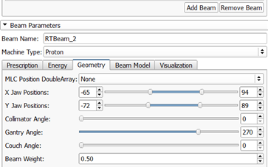
Example use case: Proton dose calculation
External beam planning
Platform for integrating dose computation engines
Common user interface for any radiation type
Potentially replace commercial TPS in low-budget scenarios
Evaluate plan
Export plan for delivery

Slide 11


Example use case: RT plan comparison in the cloud
Utilize cloud for highly parallel computations
Invoke SlicerRT functionality using scripts
Feasibility study: find most similar plan for a daily fraction from a database of plans
Initialize daily ART plan from most similar one
Scripted analysis
Local control

Slide 12

Example use case: Use custom MATLAB algorithm
Run existing MATLAB algorithm
From SlicerRT
User-friendly interface
Rely on the stable, fast implementation of
Visualization
DICOM-RT support
Dose/contour analysis
No Slicer programming required
DICOM-RT
Non-DICOM

Slide 13

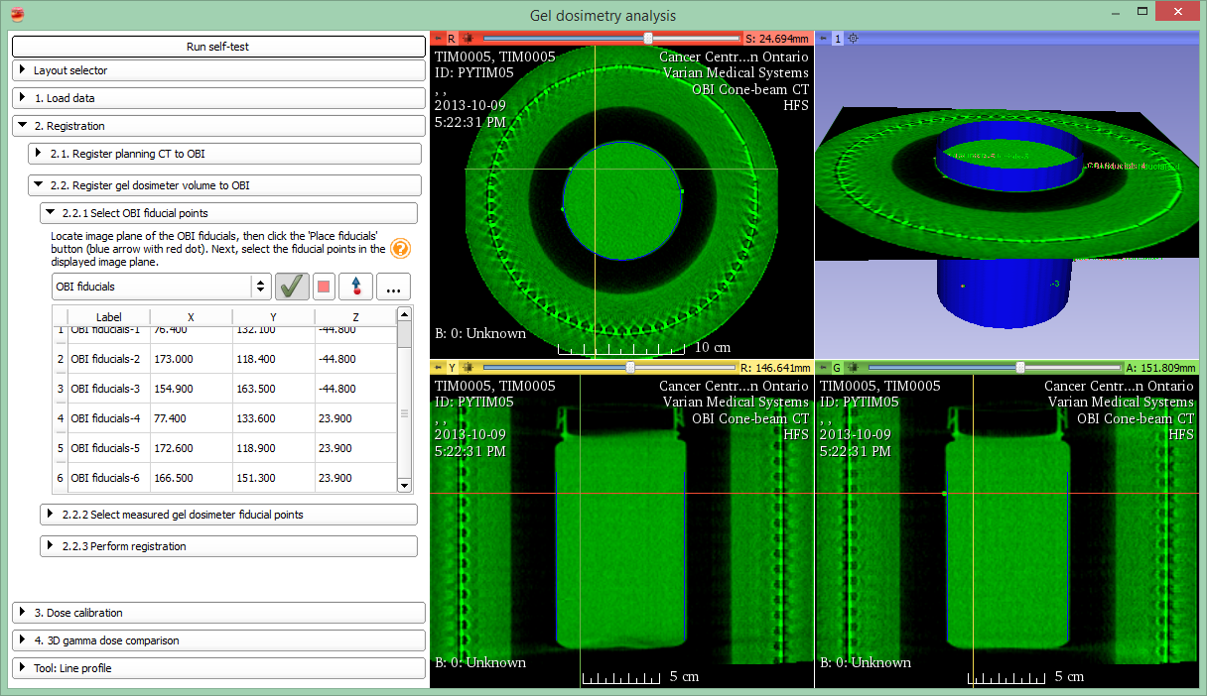
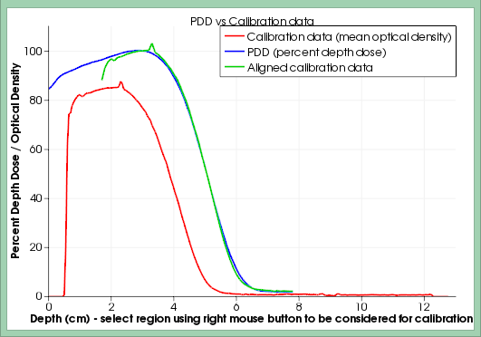
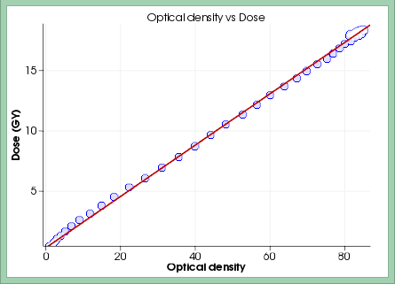
Example use case: Gel dosimetry analysis
Simplified, workflow-based user interface (slicelet)
Notes:
basically a Slicer module that includes a full layout, and can be run separately from the main Slicer window, thus allowing a simplified, workflow-based interface, so that the user can focus on the task at hand
… in detail tomorrow

Slide 14
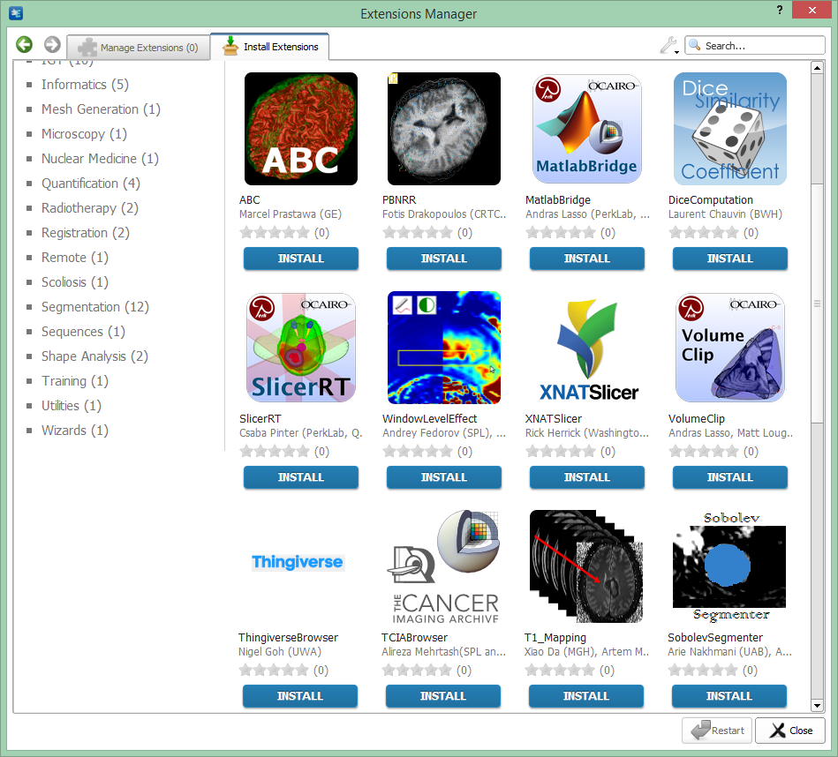

Extensions for 3D Slicer
Distributed as 3D Slicer extensions: Install and update in the Slicer extension manager
SlicerRT extension in the 3D Slicer app store (free)
Notes:
SlicerRT is distributed as a 3D Slicer extension. It can be easily found and installed from the Slicer AppStore.

Slide 15
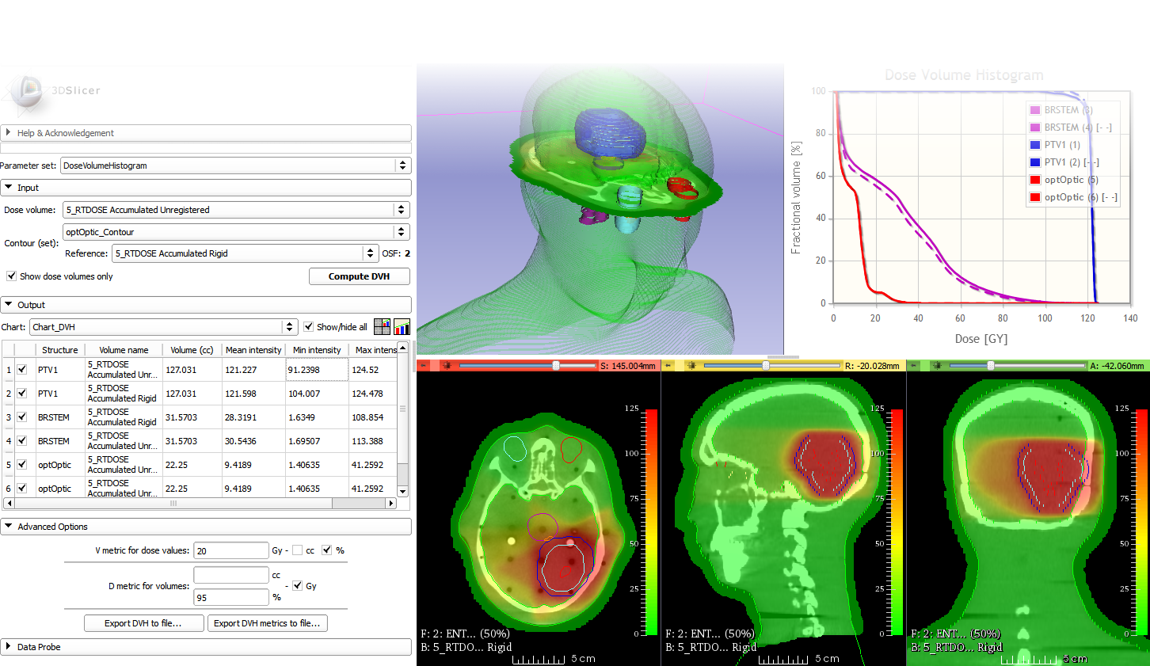


Thank you for your attention!
Inquiries: csaba.pinter@queensu.ca
Web page: http://slicerrt.org

Slide 16
Appendix

Slide 17
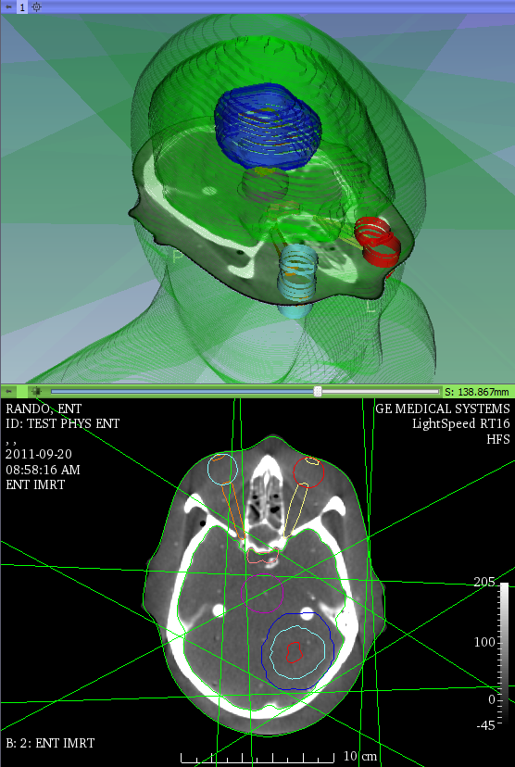
SlicerRT core highlights
Armed with the full power of 3D Slicer
DICOM-RT
Multi-fraction data handling
registration
Multi-fraction data view
Load and visualize DICOM-RT
Advanced visualizations

Slide 18
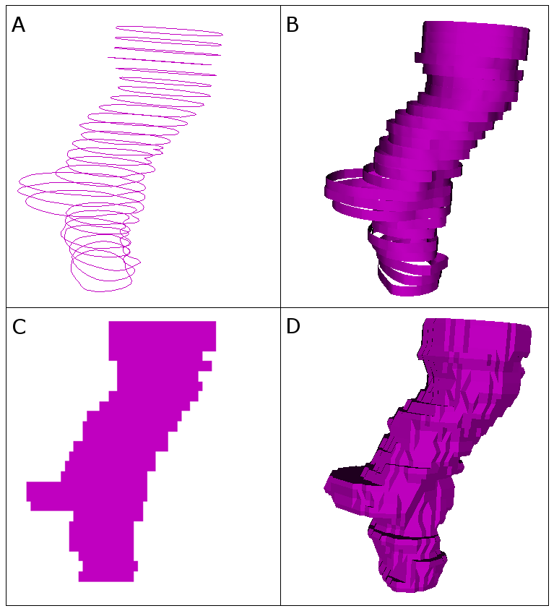
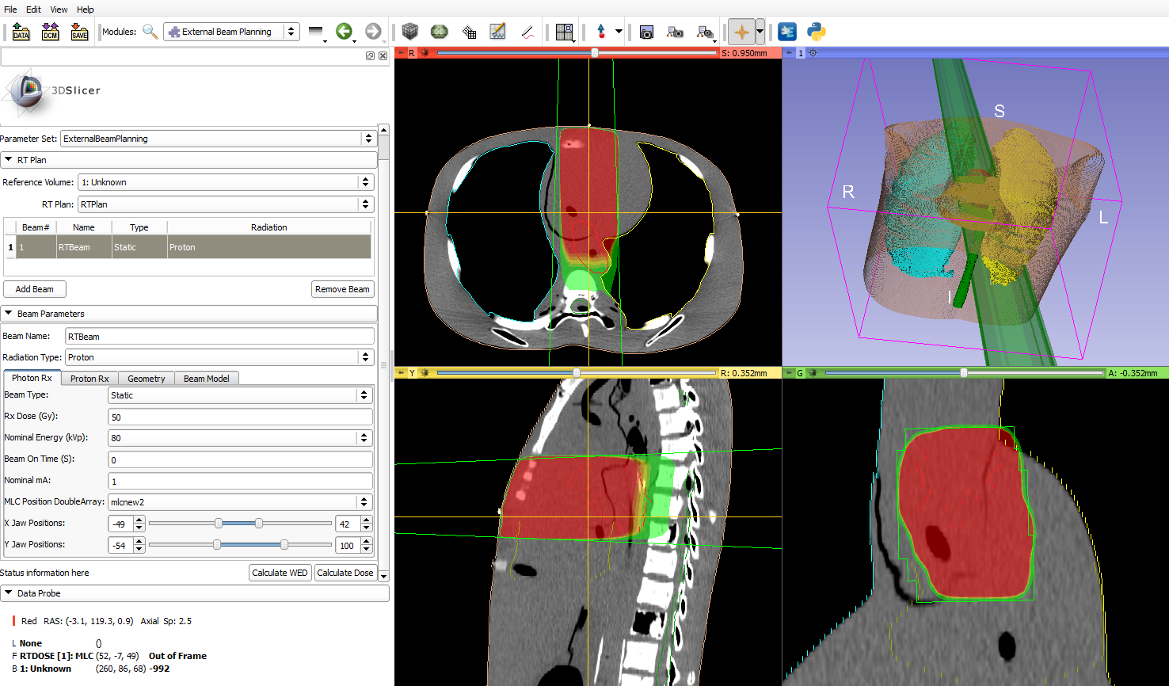
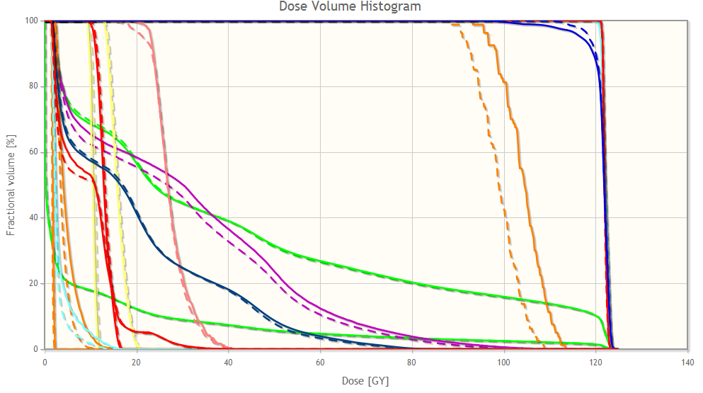
SlicerRT core highlights
Contour analysis
Multi-representation support
Morphological operators
Comparison methods
Dose analysis
DVH calculation, comparison
Gamma dose comparison
Dose accumulation
Isodose surfaces
External beam planning platform
Contour representations
Dose-volume histogram
External beam planning

Slide 19
Matlab bridge
Running Matlab functions directly from 3D Slicer
Takes input from the data loaded into Slicer
Transfers and shows the results in Slicer when MATLAB execution is completed
GUI is generated automatically from a standard command-line interface definition XML file
no GUI programming needed
No building of 3D Slicer or MEX files, etc. are needed

Slide 20
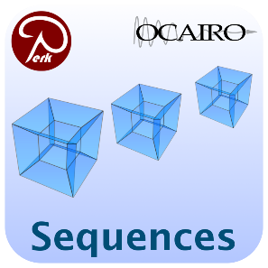
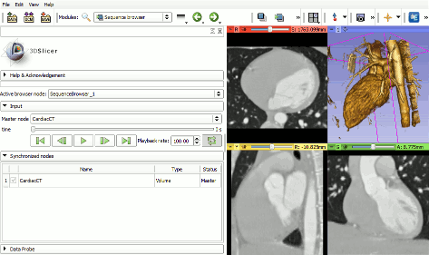
Sequences
Create and visualize of higher-dimension data nodes
RT: Multi-fraction datasets, 4D CT
Sequence browser for selection and playback
Synchronized or real-time visualization
In 2D and/or 3D
Handling of whole fraction dataset in each sequence node
Playback of a 4D cardiac CT dataset

Slide 21
Hub for RT research workflows
Routine
Research
XiO®
DICOM-RT
Pinnacle³
DICOM-RT
Eclipse™
DICOM-RT
DICOM-RT
Pinter et al. (2012). SlicerRT: Radiation therapy research toolkit for 3D Slicer. Medical physics, 39(10), 6332-6338.
Notes:
We aim SlicerRT to be a hub for…The hub approach is illustrated on the right side. It shows that SlicerRT cooperates with multiple treatment planning systems and Matlab, using their native formats.
Approach is to leverage… By doing so, we can minimize parallel developments of for example visualization or registration tools, that are otherwise crucial parts of an RT research toolkit.

